Slide 1
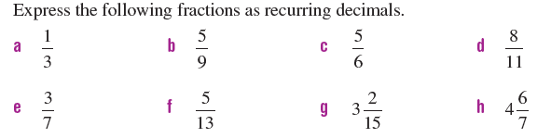
Review
How do you know if a number is rational or irrational?

Slide 2

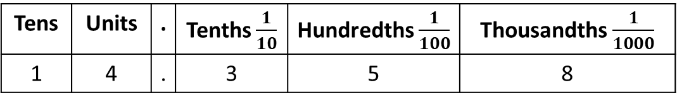
24
7
30
Decimal values
Date
EQ – How do I use round decimals and place them in order?
What is the place value of the digits in a number with decimals?
Tens | Units | . | Tenths $\frac{1}{10}$ | Hundredths $\frac{1}{100}$ | Thousandths $\frac{1}{1000}$
1 | 4 | . | 3 | 5 | 8
Gives the decimal 14.358
= $10+4+\frac{3}{10}+\frac{5}{100}+\frac{8}{1000}$
How do I order decimals?
Write in a column with the decimals points lined up.
Add zeros so the numbers have the same number of decimal places.
Write in order
Example – Write in ascending order.
0 . 512
0 . 510
0 . 500
0 . 056
0.056
0.5
0.51
0.512

Slide 3
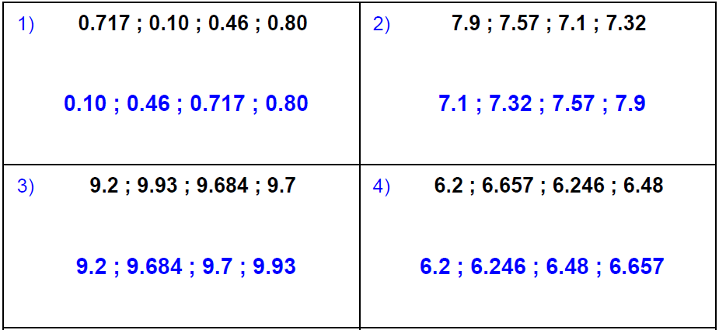
Lets Try these..
Don’t worry - the notes will be back soon

Slide 4
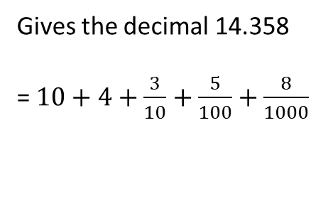
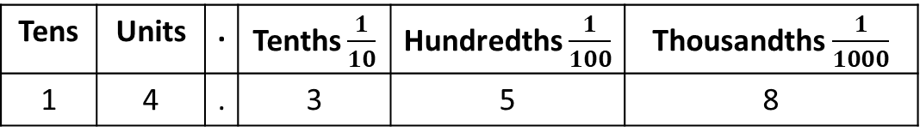
What is the place value of the digits in a number with decimals?
Tens | Units | . | Tenths $\frac{1}{10}$ | Hundredths $\frac{1}{100}$ | Thousandths $\frac{1}{1000}$
1 | 4 | . | 3 | 5 | 8
Gives the decimal 14.358
= $10+4+\frac{3}{10}+\frac{5}{100}+\frac{8}{1000}$
How do I order decimals?
Write in a column with the decimals points lined up.
Add zeros so the numbers have the same number of decimal places.
Write in order
Example – Write in ascending order.
0 . 512
0 . 510
0 . 500
0 . 056
0.056
0.5
0.51
0.512
How do I round decimals?
Find your number.
Look right next door.
4 or less just ignore.
5 or more, add 1 more.
Round to 3 decimal places (d.p)
2.689236
This digit is <5 so do nothing
Answer 2.689

Slide 5
How do I order decimals?
Write in a column with the decimals points lined up.
Add zeros so the numbers have the same number of decimal places.
Write in order
Example – Write in ascending order.
0 . 512
0 . 510
0 . 500
0 . 056
0.056
0.5
0.51
0.512
Round to 3 decimal places (d.p)
2.689236
How do I round decimals?
Find your number.
Look right next door.
4 or less just ignore.
5 or more, add 1 more.
This digit is <5 so do nothing
Answer 2.689
Round to 2 decimal places (d.p)
2.689236
This digit is >5 round up
Answer 2.69

Slide 6
Short version;
Find your number.
Look right next door.
4 or less just ignore.
5 or more, add 1 more.
Let’s try – Round the following.
24.673 to 2 d.p. b) 0.7869 to 3 d.p.
123.455 to 1 d.p. d) 42.1535 to 4d.p.
0.1996 to 3 d.p. f) 23.3452 to 1 d.p.

Slide 7
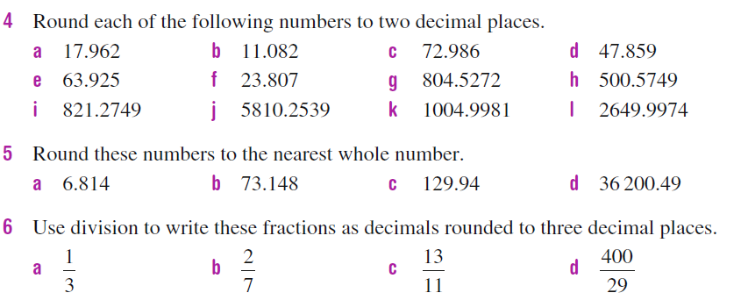
Questions
Short version;
Find your number.
Look right next door.
4 or less just ignore.
5 or more, add 1 more.
Order the following decimals in ascending order
0.231, 0.23, 0.2331, 0.223
2.455, 2.454, 2.45, 4.45
33.332, 33.233, 33.223, 33.23

Slide 8


Answers
Order the following decimals in ascending order
0.223, 0.23, 0.231, 0.2331
2.454 , 2.45, 2.455, 4.45
33.223, 33.23, 33.233, 33.332

